Slide 1
Service Oriented Architecture

Slide 2
In the Beginning …
Computers were the domain of scientists for scientists
Business and Government discovered the value of computing
Business requirements needed to be captured and programmed

Slide 3
Directions of System Architecture
1960 - 1980
1990 - 2000
2010 - 2050
Organization Focus
Mainframe Centric
Internal Use
Unique Data
Process Focus
Client Server
Partial Connectivity
EDI File Transfer
Distributed Functions
Data Centric
Universal Interoperability
Real-time Connectivity

Slide 4
What is a Service?
A service is a reusable component that can be used as a building block to form larger, more complex business-application functionality.
A service may be as simple as “get me some person data,” or as complex as “process a disbursement.”

Slide 5
What is a Service?
A service provides a discrete business function that operates on data. Its job is to ensure that the business functionality is applied consistently, returns predictable results, and operates within the quality of service required.

Slide 6
Continued…
How the service is implemented, and how a user of the service accesses it, are limited only by the SOA infrastructure choices of the enterprise.
From a theory point of view, it really doesn’t matter how a service is implemented.

Slide 7
Characteristics of a Service
Loose coupling: The consumer of the service is required to provide only the stated data on the interface definition, and to expect only the specified results on the interface definition. The service is capable of handling all processing (including exception processing).
Services are independent. They don’t know or care whether the service is:
Running on Windows, J2EE or a Mainframe
Written in assembler, C, Java, or COBOL.
Running on a machine in the U.S., India, or China
Being served by a CRM system, a DDA system, or a database
This enables different (legacy) systems to supply information in a consistent way using SOA.

Slide 8
Characteristics of a Service
Supports open standards for integration: Although proprietary integration mechanisms may be offered by the SOA infrastructure, SOA’s should be based on open standards. Open standards ensure the broadest integration compatibility opportunities.

Slide 9
Characteristics of a Service
Stateless: The service does not maintain state between invocations. It takes the parameters provided, performs the defined function, and returns the expected result. If a transaction is involved, the transaction is committed and the data is saved to the database.

Slide 10
Characteristics of a Service
Location agnostic: Users of the service do not need to worry about the implementation details for accessing the service. The SOA infrastructure will provide standardized access mechanisms with service-level agreements.

Slide 11
What is Service-Oriented Architecture?

Slide 12
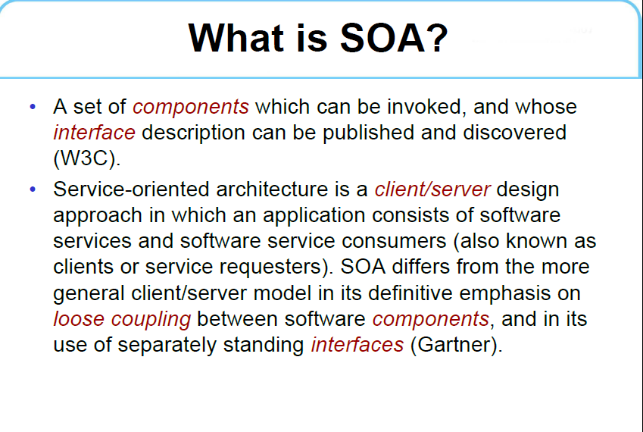

Slide 13
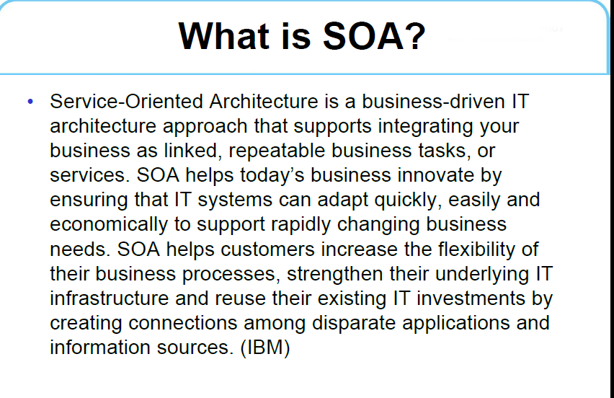

Slide 14
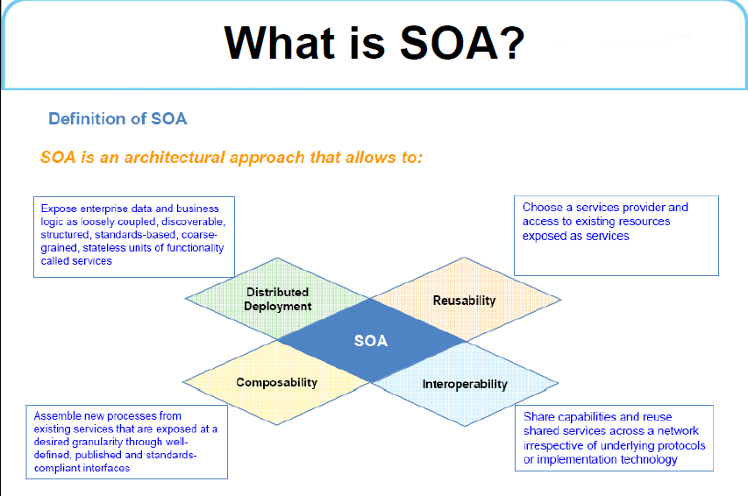

Slide 15
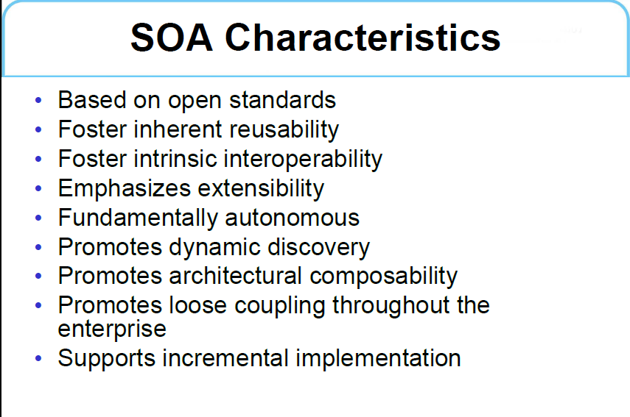

Slide 16
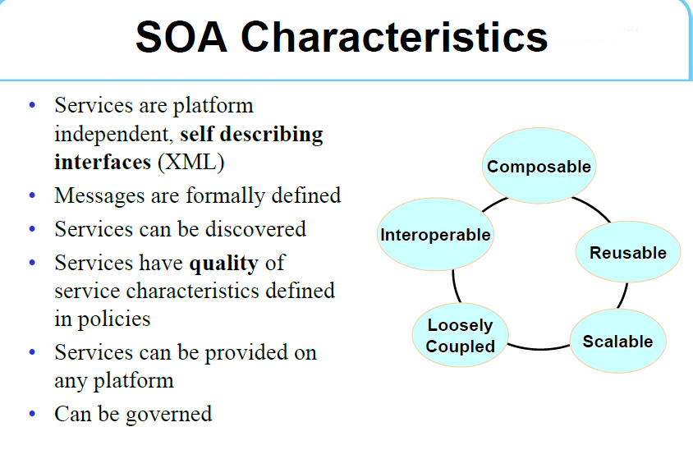

Slide 17
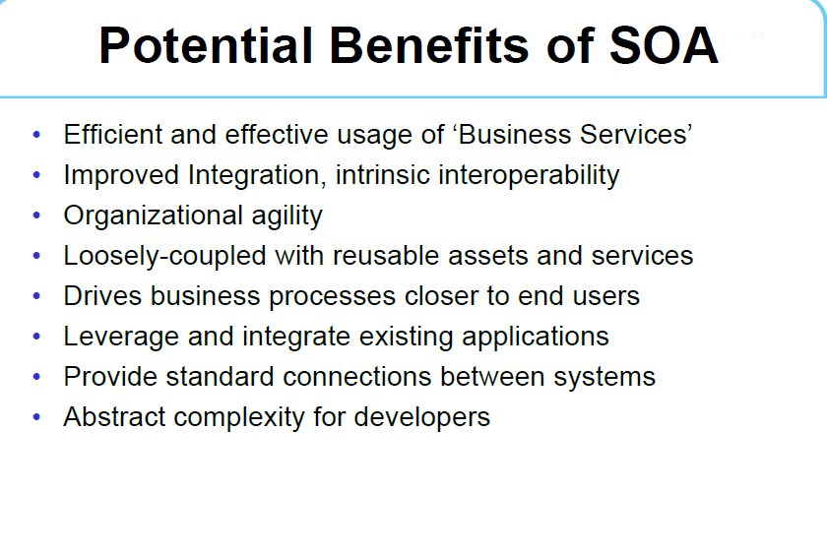

Slide 18
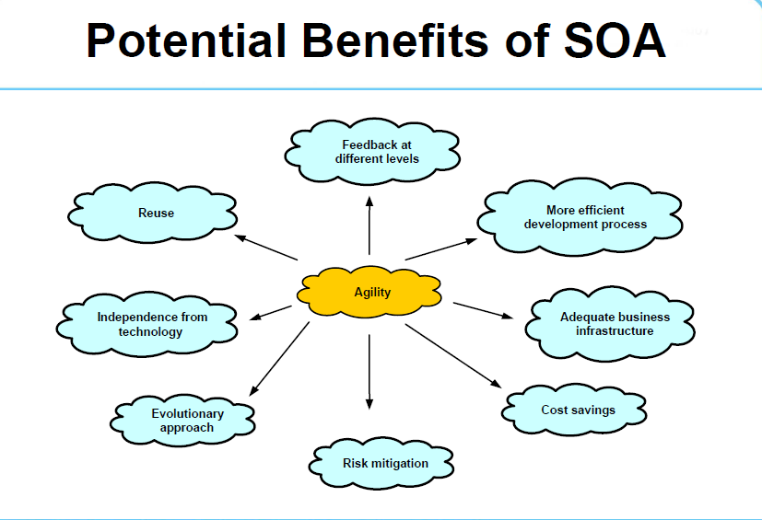

Slide 19
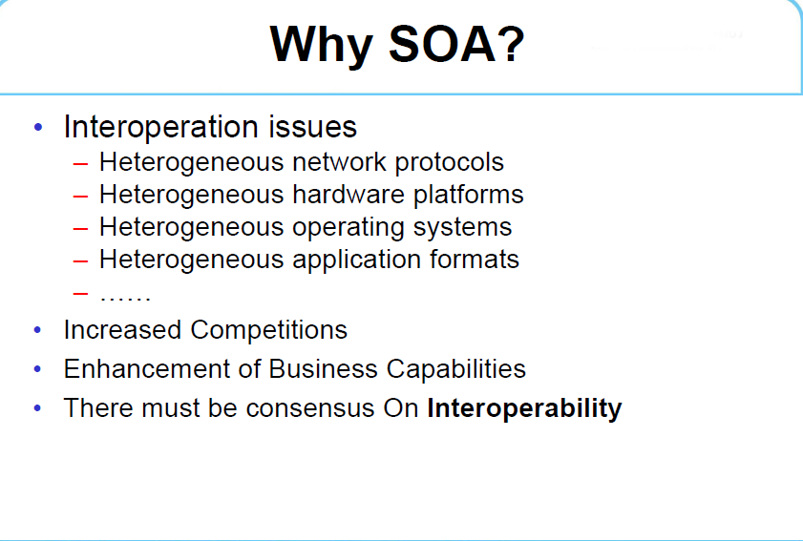

Slide 20
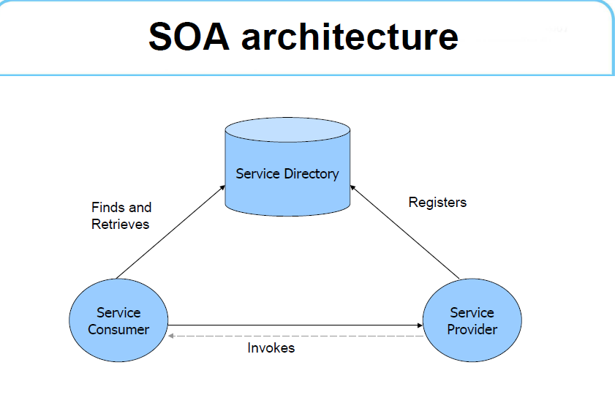

Slide 21
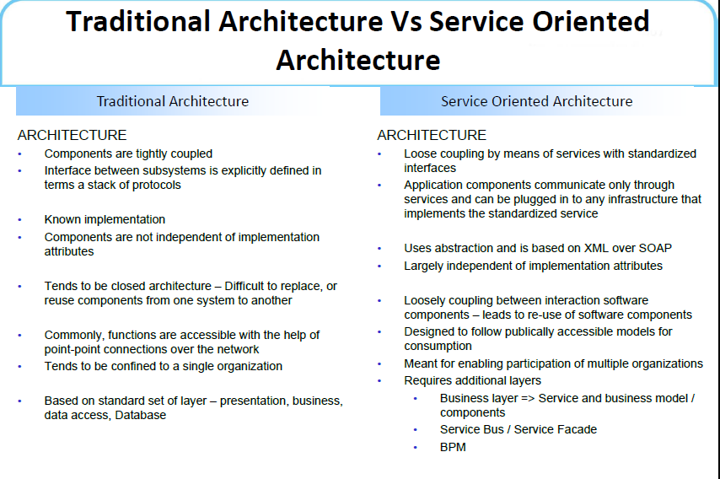

Slide 22
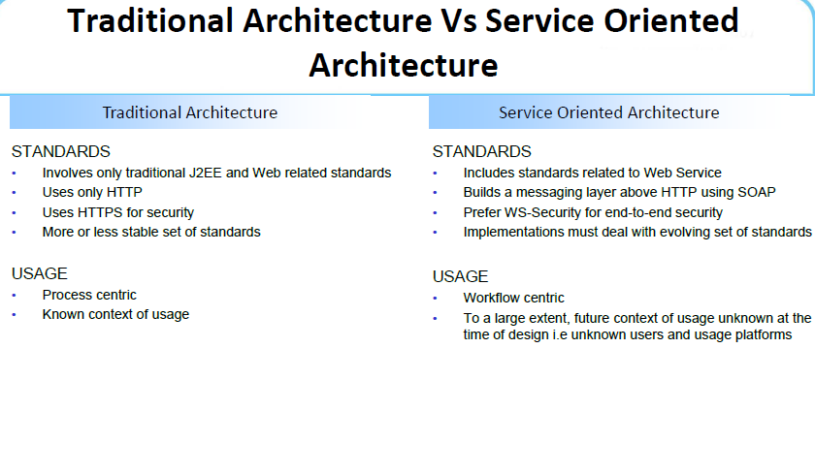

Slide 23
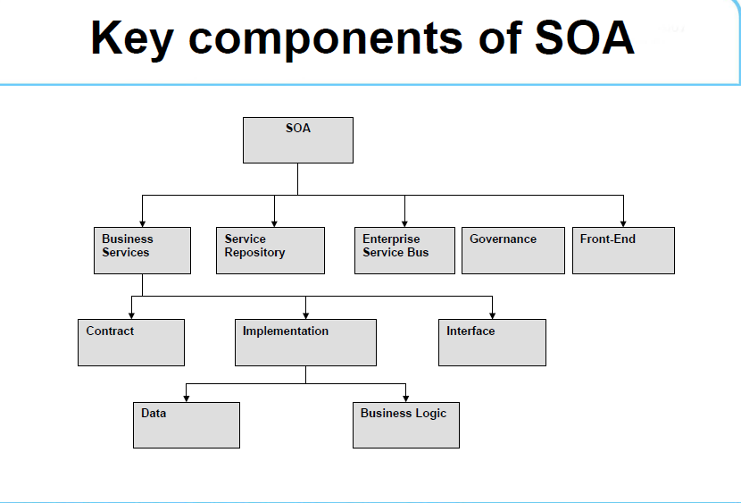

Slide 24
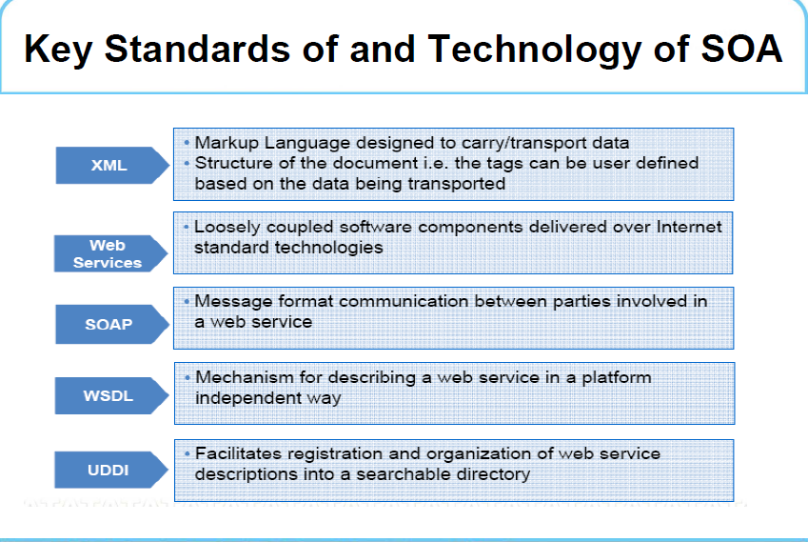

Slide 25
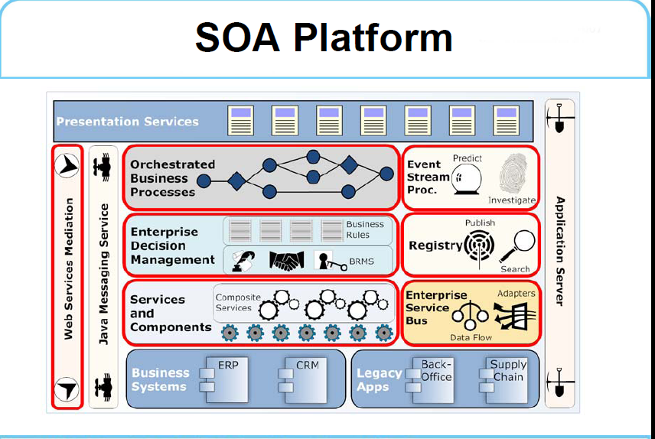

Slide 26
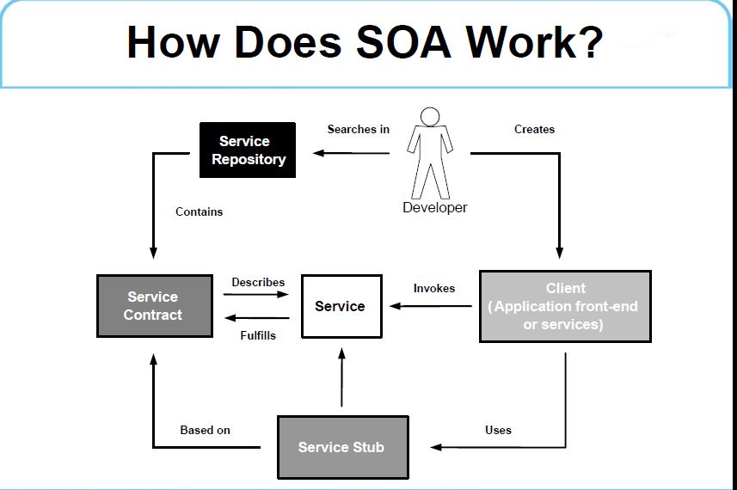

Slide 27
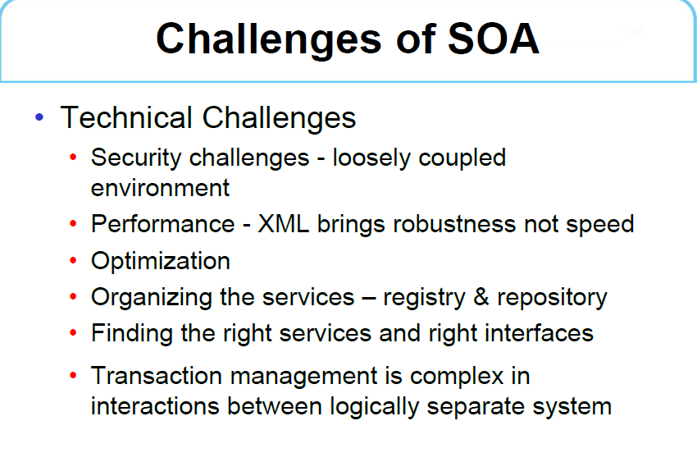

Slide 28
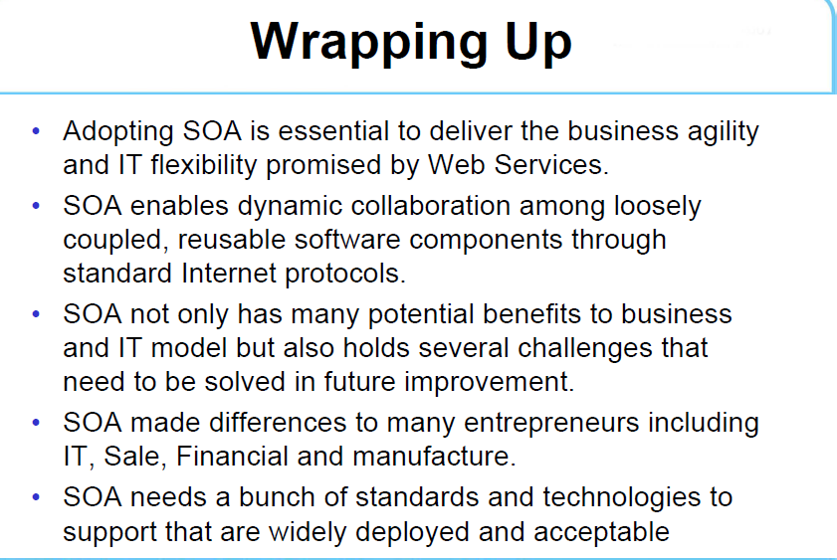

Slide 29
What is Service-Oriented Architecture?
Service-Oriented Architecture (SOA) is an architectural style. Applications built using an SOA style deliver functionality as services that can be used or reused when building applications or integrating within the enterprise or trading partners.

Slide 30
SOA
Uses open standards to integrate software assets as services
Standardizes interactions of services
Services become building blocks that form business flows
Services can be reused by other applications

Slide 31
What is a Service Oriented Architecture (SOA)?
A method of design, deployment, and management of both applications and the software infrastructure where:
All software is organized into business services that are network accessible and executable.
Service interfaces are based on public standards for interoperability.

Slide 32
Key Characteristics of SOA
Quality of service, security and performance are specified.
Software infrastructure is responsible for managing.
Services are cataloged and discoverable.
Data are cataloged and discoverable.
Protocols use only industry standards.

Slide 33
What is a “Service”?
A Service is a reusable component.
A Service changes business data from one state to another.
A Service is the only way how data is accessed.
If you can describe a component in WSDL, it is a Service.

Slide 34
SOA Definitions
What is a SOA?
OASIS: “paradigm for organizing and utilizing distributed capabilities that may be under the control of different ownership domains. It provides a uniform means to offer, discover, interact with and use capabilities to produce desired effects consistent with measurable preconditions and expectations.”

Slide 35
SOA definitions, cont.
Erl: “Contemporary SOA represents an open, agile, extensible, federated, composable architecture comprised of autonomous, QoS-capable, vendor diverse, interoperable, discoverable, and potentially reusable services, implemented as Web services.
SOA can establish an abstraction of business logic and technology, resulting in a loose coupling between these domains.
SOA is an evolution of past platforms, preserving successful characteristics of traditional architectures, and bringing with it distinct principles that foster service-orientation in support of a service-oriented enterprise.
SOA is ideally standardized throughout an enterprise, but chieving this state requires a planned transition and the support of a still evolving technology set.”

Slide 36
SOA Definitions, cont.
OMG: “Service Oriented Architecture is an architectural style for a community of providers and consumers of services to achieve mutual value, that:
Allows participants in the communities to work together with minimal co-dependence or technology dependence
Specifies the contracts to which organizations, people and technologies must adhere in order to participate in the community
Provides for business value and business processes to be realized by the community
Allows for a variety of technologies to be used to facilitate interactions within the community”

Slide 37
SOA definitions, cont.
W3C: “A form of distributed systems architecture that is typically characterized by the following properties:
Logical view: The service is an abstracted, logical view of actual programs, databases, business processes, etc., defined in terms of what it does, typically carrying out a business-level operation.
Message orientation: The service is formally defined in terms of the messages exchanged between provider agents and requester agents, and not the properties of the agents themselves. The internal structure of an agent, including features such as its implementation language, process structure and even database structure, are deliberately abstracted away in the SOA: using the SOA discipline one does not and should not need to know how an agent implementing a service is constructed. A key benefit of this concerns so-called legacy systems. By avoiding any knowledge of the internal structure of an agent, one can incorporate any software component or application that can be "wrapped" in message handling code that allows it to adhere to the formal service definition.
Description orientation: A service is described by machine-processable meta data. The description supports the public nature of the SOA: only those details that are exposed to the public and important for the use of the service should be included in the description. The semantics of a service should be documented, either directly or indirectly, by its description.
Granularity: Services tend to use a small number of operations with relatively large and complex messages. Network orientation: Services tend to be oriented toward use over a network, though this is not an absolute requirement. Platform neutral: Messages are sent in a platform-neutral, standardized format delivered through the interfaces. XML is the most obvious format that meets this constraint. “

Slide 38
SOA definition, cont.
Open Group: “An architectural style that supports service orientation …
Service orientation
A way of a way of thinking in terms of services and service based development and the outcomes that services bring Service
A logical representation of a repeatable business activity that has a specified outcome (e.g., check customer credit; provide weather data, consolidate drilling reports), is self-contained and maybe composed of other Services. It is a black box to consumers of the Service Architectural Style
The combination of distinctive features in which Enterprise Architecture is done, or expressed The SOA Architectural styleﾕs distinctive features: Based on the design of the services comprising an enterprise’s (or inter-enterprise) business processes. Services mirror real-world business activity
Service representation utilizes business descriptions. Service representation requires providing its context (including business process, goal, rule, policy, service interface and service component) and service orchestration to implement service Has unique requirements on infrastructure. Implementations are recommended to use open standards, realize interoperability and location transparency. Implementations are environment specific, they are constrained or enabled by context and must be described within their context. Requires strong governance of service representation and implementation Requires a Litmus Test, which determined a good services”

Slide 39
SOA: the basics
What it is.
What it is not.

Slide 40
Real SOA
Changed mindset: service-oriented context for business logic.
Changed automation logic: service-oriented applications.
Changed infrastructure: service-oriented technologies.
A top-down organization transformation requiring real commitment.

Slide 41
SOA Characteristics
Loosely coupled: minimizes dependencies between services.
Contractual: adhere to agreement on service descriptions.
Autonomous: control the business logic they encapsulate.
Abstract: hide the business logic from the service consumers.

Slide 42
SOA Characteristics
Reusable: divide business logic into reusable services.
Composable: facilitate the assembly of composite services.
Stateless: minimize retained information specific to an activity.
Discoverable: self-described so that they can be found and assessed.

Slide 43
Potential Benefits
Based on open standards.
Supports vendor diversity.
Fosters intrinsic interoperability.
Promotes discovery.
Promotes federation.
Fosters inherent reusability.
Emphasizes extensibility.

Slide 44
Potential Benefits
Promotes organizational agility.
Supports incremental implementation.
Technical architecture that adheres to and supports the principles of service orientation.

Slide 45
What is SOA?
Loosely coupled modular services to support both business and IT requirements.
So what does that mean?

Slide 46
Loosely coupled
Services are independent. They don’t know or care whether the service is:
Running on Windows, J2EE or a Mainframe
Written in assembler, C, Java, or COBOL.
Running on a machine in the U.S., India, or China
Being served by a CRM system, a DDA system, or a database
So what does that do for me?
Enables a myriad of different (legacy) systems to supply information in a consistent way using SOA.

Slide 47
Modular
Services are no longer monolithic applications, but broken into compound and granular services.
Example: Initiating a transfer is a compound service, that might comprise the following granular services:
Find customer
Authenticate customer
Find all accounts and balances (for display)
Find account (the funding account)
Get account balance (to verify availability of funds)
Find account (the receiving account)
Debit account (the funding account)
Credit account (the receiving account)
Find all accounts and balances (for re-display)

Slide 48
So what does modular do for me?
Note that in the previous example we reused a number of services within the compound service.
Other compound services will reuse these services as well, driving consistency (= lower risk), lower cost, and flexibility.

Slide 49
SOA is an IT architecture consisting of loosely coupled modular services to support both business and IT requirements.
Loosely coupled: runs on a myriad of applications, systems, platforms and locations to tie together new and legacy systems
Modular: broken into compound and granular services to enable reuse
Business and IT: across the entire organization.

Slide 50
SOA from a technical viewpoint
Today SOA is used to broadly define a set of products and services that range from data conversion services, to portal tools.

Slide 51
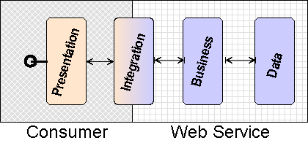
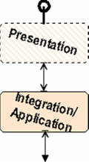
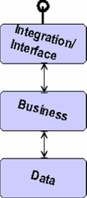
SOA from a technical viewpoint: SOA Application – 2 Partners
Two Partners Scenario
Application (Consumer)
Web Service (Provider)
Web Service Side
Interface
Business Logic
Data
Consumer Side
Presentation
Application

Slide 52
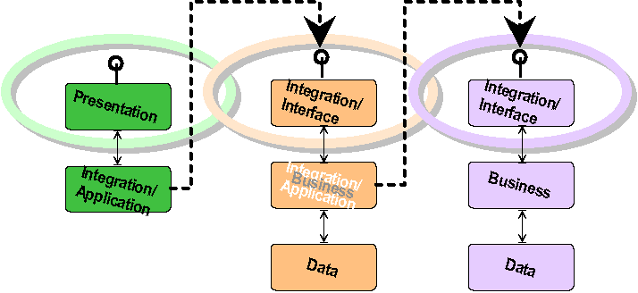
SOA Application – 3 Partners
Three partners scenario
One client application
Two Web services, one references the other

Slide 53
Order Placement
Discount
Calculation
Order
Placement
Tax
Calculation
Shipping
Calculation
Supporting services may reside
somewhere else,
provided by someone else

Slide 54
Information Integration
Financial
Instrument
Mortgage
Quote
Financial
Instrument
Financial
Instrument
New services offering
different features can
be added as needed

Slide 55
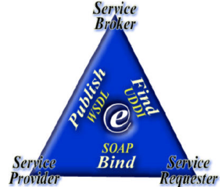
Publish/Find/Bind Model
The service provider publishes its service(s) to a service registry such as UDDI in the form of a WSDL document.
The service requestor finds services for consumption via service registries and this process is also called “service discovery.”
Once the service requestor has acquired the service information, it can attempt to bind to the service and use it.
Adapted from Mohen, C. (2002). “Tutorial: Application Servers and Associated Technologies,”
ACM SIGMOD International Conference on Management of Data (SIGMOD'02), Madison, USA, June 2002.

Slide 56
Use of SOA
Publishing of business functions by means of API
Web pages for humans (B2C)
Web services for program to program (B2B)
Bank
Get Quote
E-Retailer
Logistics Company
Reservation
Internet
Supplier
A programmable application component accessible via standard Web protocols
Purchase
Order
Buyer

Slide 57
More SOA Scenario
Logistic Company
Bank
Web Service Shipping Order
J2EE
COM
Web Service Credit Card Check
Internet
SOAP
SOAP
SOAP
Shop Application
RPC
Web Service Order Fulfillment
Web Service
E-Retailer
Supplier
Notes:
These applications at a bank, a logistic company and a supplier all use different protocols for communication between application components.
The shop application at the E-Tailer needs functions from all these applications. With traditional middleware the shop application would have to talk CORBA IIOP to the bank application, DCOM to the logistics application, and a propiretary RPC protocol to the supplier's application. Making the required applications' functions available as web services allows the E-Tailer's shop application to access these various services via the Internet using standard protocols like HTTP and SOAP (Simple Object Access Protocol). The web service handlers within the individual organizations are responsible for transforming the SOAP request into the according protocol that the application function that implements the service understands.

Slide 58
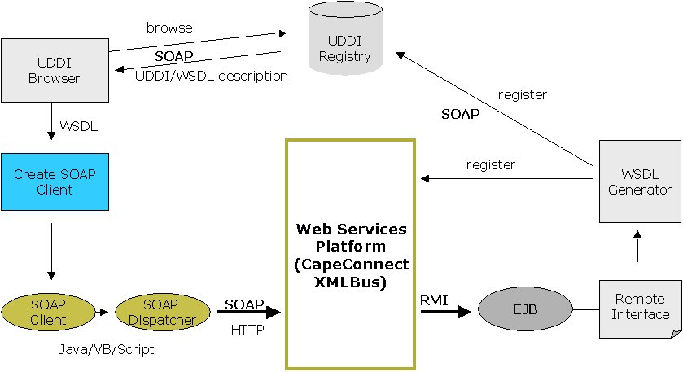
SOA Communication Infrastructure
Web Service Broker
Reproduced with the kind permission of John McGuire Cape Clear Software
Discover Service
Publish Service Description
Web
Service
Requester
Get Service Description
Use Service based on Service Description
Web Service Provider
Notes:
See also: WSA from W3C: Figure 1-1 http://www.w3.org/TR/2004/NOTE-ws-arch-20040211/

Slide 59
Why SOA? - Summary
SOA allows us to share processes over the Internet
independent of platform, tools, or technology
Anyone, anywhere, any device, anytime
It is a better integration solution for process sharing
Applications become services
Services are accessible
Services enable integration
EAI
B2B
It will create new business models that we have yet to conceive
Services can be assembled and reused
Based on open standards: XML and SOAP
“Plug and Play” applications
Delivering on the age-old promise of reusability
Notes:
Add these points:
Properties of Web Services:
Loosely-coupled: Web services can run independently of each other on entirely different implementation platforms and run-time environments.
Encapsulated: The only visible part of a Web service is the public interface, e.g., WSDL and SOAP.
Standard Protocols and Data Formats: The interfaces are based on a set of standards, e.g., XML, WSDL, SOAP, UDDI and etc.
Invoked Over Intranet or Internet: Web services can be executed within or outside the firewall.
Components: The composition of Web services can enable business-to-business transactions or connect the internal systems of separate companies, such as workflow. Workflow is a computer supported business process.
Business Oriented: Web services are not end-user software!

